Slide 1
AJAX and APIs
Day 17
March 2, 2017

Slide 2
API Recap

Slide 3
Recap Questions
What is an API?

Slide 4
Recap Questions
What is an API?
“An Application Programming Interface (API) offers a set of pre-defined routines, code snippets, and tools for building software applications”

Slide 5
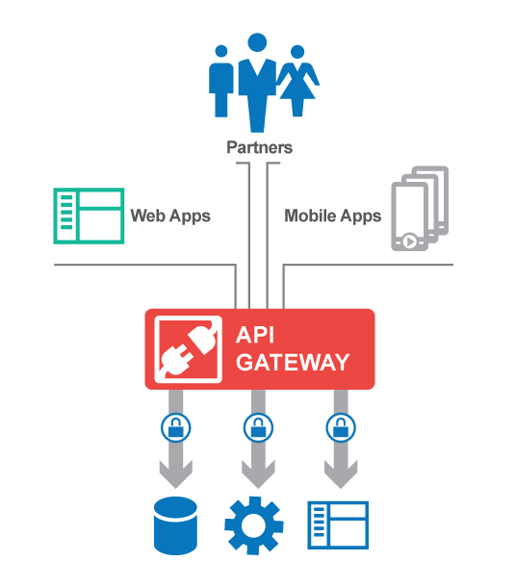
Recap Questions
In software development APIs are often the bridge between different components

Slide 6
API Use Cases

Slide 7
API Use Cases
Three Common Use-Cases for APIs:
To provide pre-built code for getting and sending data to a centralized database (e.g. Weather Data, IMDB Movie Data).
To provide pre-build code for creating or utilizing other software components (e.g. Google Maps, Spotify Tools).
To interface with physical sensors or hardware devices. (e.g. Nest Thermostat, Phillips Hue)

Slide 8


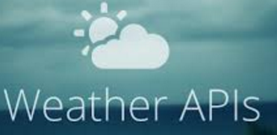

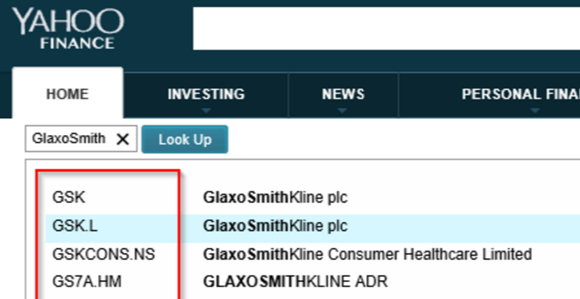


Use Case #1 – Accessing and Sending Data

Slide 9
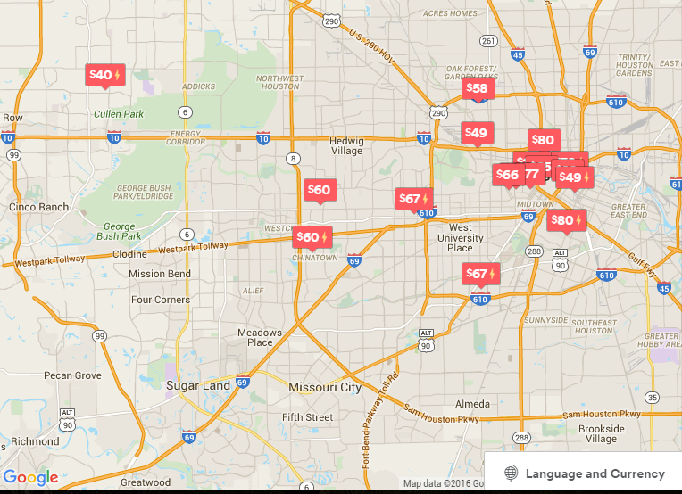

Use Case #2 – Utilizing Pre-Built Code
Example: AirBNB utilizes the Google Maps API to power its entire mapping service

Slide 10
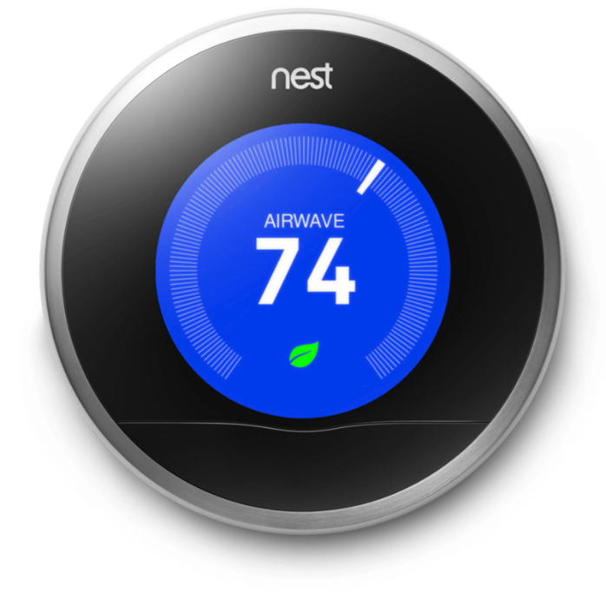
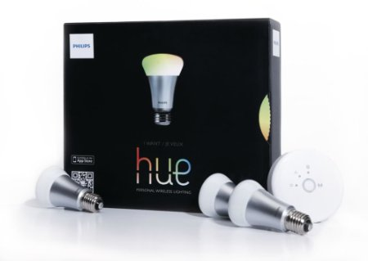
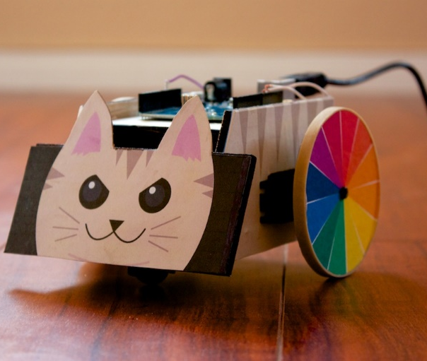
Use Case #3 – Controlling Physical Hardware
Nest Smart Thermostat API: https://developer.nest.com/
Phillips Hue API: http://www.developers.meethue.com/
NodeBots (Ceylon) API: https://cylonjs.com/

Slide 11

Use Case #3 – Controlling Physical Hardware
HueCraft: https://www.youtube.com/watch?v=ovYORLkO5bQ

Slide 12
JSON Recap

Slide 13
Recap Questions
What is a JSON?

Slide 14
Recap Questions
What is a JSON?
JSON stands for Javascript Object Notation and is nothing more than simple Javascript Objects used as a “data interchange format”.

Slide 15
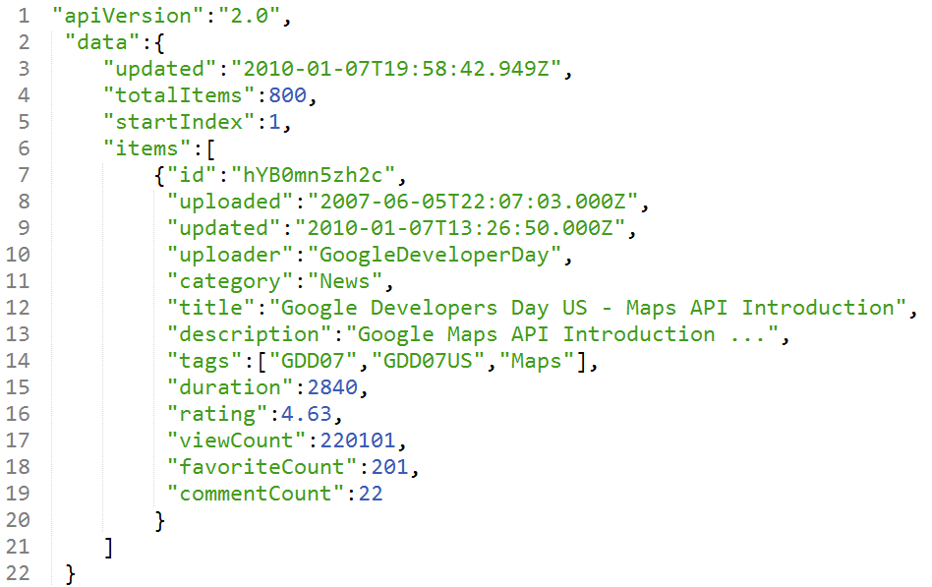
Recap Questions
JSON is a lightweight data-interchange format used to correlate keys with values

Slide 16
Getting Data

Slide 17
Recap Questions
What jQuery method do we use to retrieve data from a URL database?

Slide 18
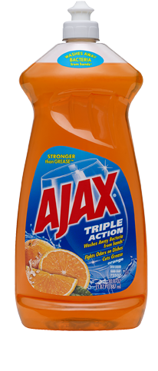
Recap Questions
What jQuery method do we use to retrieve data from a URL database?
AJAX!!!!!

Slide 19
Recap Questions
What two parameters do we pass into AJAX to retrieve data from online?

Slide 20
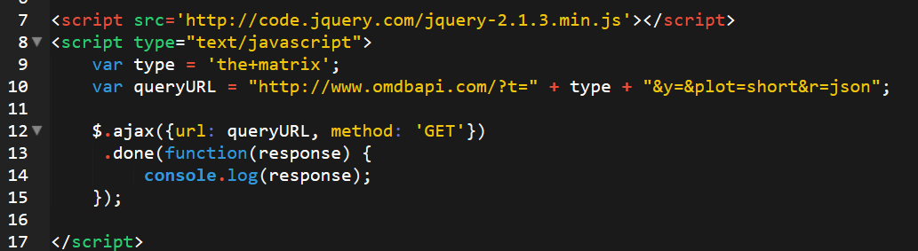
Recap Questions
What two parameters do we pass into AJAX to retrieve data from online?
Url and method: ‘get’

Slide 21

Recap Questions

Slide 22
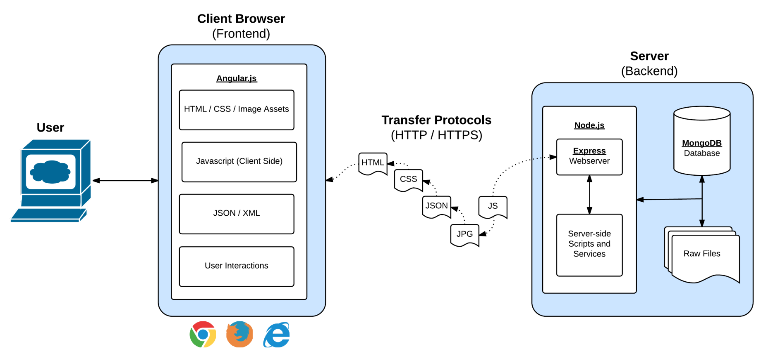
Welcome to “Full-Stack” Development
Full-Stack Development is the concept of building every aspect of the web application – from the visuals and interactions, to the data transfer and processing.

Slide 23
Overview
At this point, you should…
Understand what an API is.
Understand what JSON means.
Realize that AJAX Methods are used for retrieving data in databases.
Know how to create a basic AJAX GET Request using jQuery. (i.e. include URL and “GET”)

Slide 24
Questions

